Slide 1
IGNITE Program
Enhancing Customer Correspondence Prioritization with Machine Learning

Slide 2
Mentors
Team Members
Swaroop
Vivek TM
Athul Ananth Ariga
Katkam Srinvas
Varun Singhal
Rajesh Vasant Mhatre
Operations SPOC
Daita Sangeetha

Slide 3
Problem Statement
Correspondence received from customers might make references to their dissatisfaction with the service received. Such correspondence needs to be identified and dealt with as a higher priority as compared to normal requests. We have missed such correspondence in the past as we might not have understood the subject, severity or the tone of the letter.
Line Of Business: LTC
Process: LTC Indexing

Slide 4
Solution Overview
Approach:
Text Extraction: Extract text from customer correspondence.
Sentiment Analysis: Use ML to analyze sentiment, identifying dissatisfied tones.
Current Status:
Phase 1 - Text Extraction: Completed.
Phase 2 - Sentiment Analysis: In development.

Slide 5
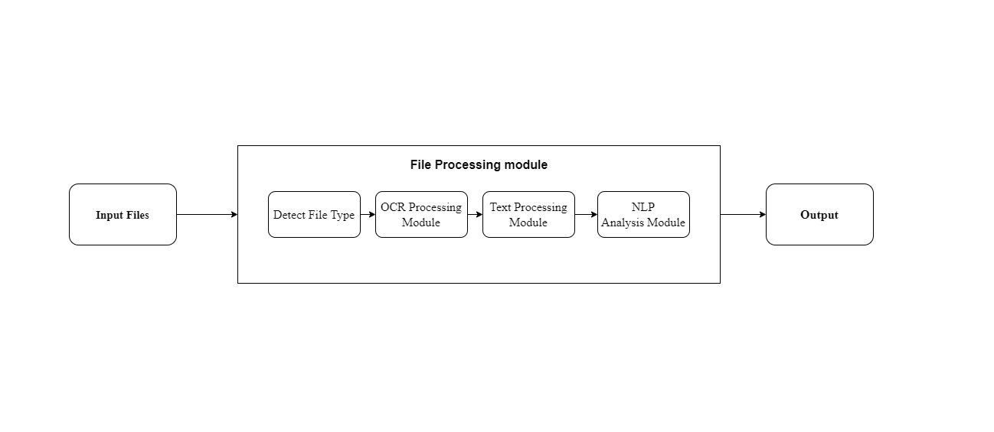
Architecture Diagram

Slide 6
Architecture Diagram
Input Files: Represents the scanned documents in `.pdf` or `.TIF` format.
File Processing Module:
Detect File Type: Identifies whether the input file is a `.pdf` or `.TIF`.
OCR Processing Module: Extracts text using OCR for scanned documents.
Text Processing Module: Cleans and prepares the extracted text for analysis.
NLP Analysis Module: Extracts keywords and performs sentiment analysis.
Output: The result after processing and analysis.

Slide 7
Module 1 - Text Extraction
Function: Extracts text from customer correspondence in multiple formats (.pdf, .TIF).
Current Status: Completed
Process Summary:
Input Folder: Documents needing processing are placed in the input folder.
Execution: A Python script runs, using an OCR module to extract text from each document.
Output Storage: Extracted text is stored in an output folder, with text files corresponding to each input document.
Archiving: Once processed, original documents are moved to an archive folder

Slide 8
Module 2 - Sentiment Analysis (In Progress)
Purpose : Identifies customer sentiment to flag potential dissatisfaction.
Current Status: In Development (Phase 2).
Expected Outcomes: Each document will be tagged as either "Compliance" or "Appeal" based on its sentiment.

Slide 9
Impact of potential solution
Improved Accuracy & efficiency
Increased customer confidence and Better Customer Service
Compliance with a regulatory process

Slide 10
Questions & Discussion

Slide 11
Thank You

